Slide 1
Intro to NoSQL
ASHFI SHAH (TA)
ON BEHALF OF MR. KAZI AMIT HASAN
18 March 2026
You can reach me at ashfi.shah@queensu.ca

Slide 2
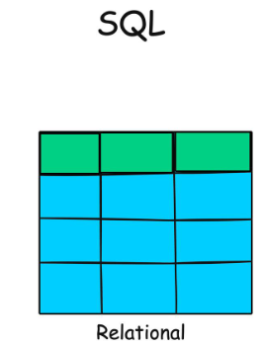
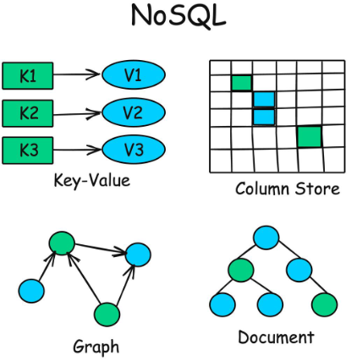
WHAT IS NoSQL?
CISC332
Slide 2 of 20
18 March 2026
NoSQL is shortform for ‘Not Only SQL’
NoSQL is flexible and ideal for unstructured/semi-structured data
Does not rely on the traditional relational table model
Very good for Big Data
NoSQL can serve
Key-values (e.g. Redis, DynamoDB, Cassandra)
Column Store (e.g. Amazon Redshift, Google Big Query, Druid)
Documents (e.g. Firebase, MongoDB, Amazon Document DB)
Graphs (e.g. Neo4J, Amazon Neptune, Arango DB)

Slide 3
STRUCTURED? SEMI-STRUCTURED? UNSTRUCTURED?
CISC332
Slide 3 of 20
18 March 2026
FEATURE | STRUCTURED | SEMI-STRUCTURED | UNSTRUCTURED
DEFINITION | Organised (Typically rows and columns) | Partially Organised (Can use tags or markers) | Not Organised (No predefined format, raw data)
SCHEMA | Strict and predefined (E.g. Tables) | Flexible schema (Which has metadata) | No schema (Highly Flexible)
STORAGE FORMAT | Relational Database (SQL) | JSON, XML, YAML, NoSQL Databases | Text files, Images, NoSQL Databases
SCALABILITY | Vertical Scaling (Bigger Server) | Horizontal Scaling (Distributed Systems) | Requires Specialised Storage and Indexing
EXAMPLES | Customer Databases | HTML, JSON | Social Media Posts, Images

Slide 4
BIG DATA (1/2)
CISC332
Slide 4 of 20
18 March 2026
BIG DATA is data which has sizes, generation rates, and complexity that does not work with traditional data management systems
Solution: A specialised infrastructure designed to store, process, and analyse massive volumes of structured, semi-structured, and unstructured data efficiently
Big Data can be defined by these 5 Vs:
Volume – Massive amounts of data are generated every second
Velocity – Real-time analytics and streaming data
Variety – Different types of data formats and sources
Veracity (Reliability) and Value (Usefulness)

Slide 5
BIG DATA (2/2)
CISC332
Slide 5 of 20
18 March 2026
Characteristics of a Big Data system
Scalable – handles large and growing datasets
Fault-tolerant – can recover from failure
Distributed – data and processing is spread across multiple machines
High-speed processing – Enables real-time and batch analytics
Examples of Big Data tasks
Social media analytics
Indexing billions of web pages
Real-time recommendation systems

Slide 6
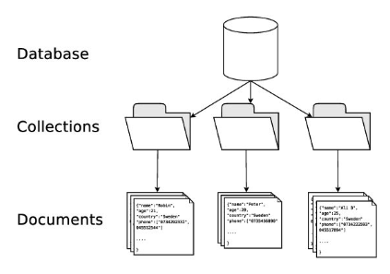
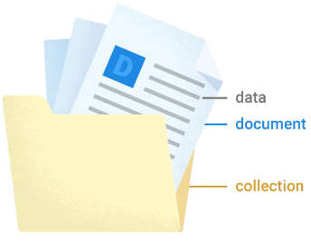
DOCUMENT BASED DATABASES
CISC332
Slide 6 of 20
18 March 2026
Use collections and documents rather than tables
Documents are the unit of storage
Document: A record with unique fields which map to values
Complex nested objects are called maps
Names must be unique
Collections are containers for documents
Do not hold fields – just documents
Make querying easier

Slide 7
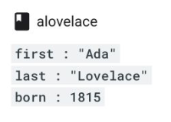
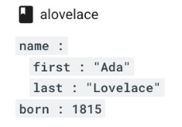
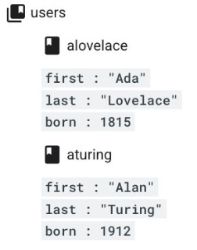
EXAMPLES
CISC332
Slide 7 of 20
18 March 2026
1
2
3
4
A simple document discussing Ada Lovelace
Another document about Ada Lovelace, but her name is now organised into a map
Taking Ada Lovelace’s document from (1), we can make a collection. We can have more documents, such as for example Alan Turing
Notice in this collection, no documents share the same name. If we instead of aturing put the second alovelace, that would not work.
Fun Fact:
Who are these examples?
Ada Lovelace (1815-1852) is the first programmer
Alan Turing (1912-1954) is one of the fathers of AI, but also played a key role in cryptography

Slide 8

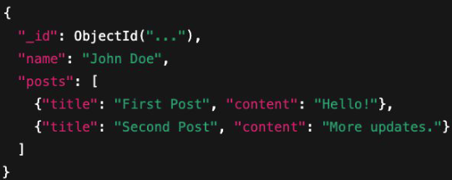
DOCUMENT/COLLECTION MODELS
CISC332
Slide 8 of 20
18 March 2026
FEATURE | FIRESTORE | MONGODB
DATA ORGANISATION | Strictly hierarchical: Data is organised in a pattern: Collection → document → subcollection → document | Flexible Binary JSON structure (BSON): Collections contain documents with nested fields
DOCUMENTS | Cannot contain other documents directly, only subcollections | Contain arrays and embedded sub-documents directly
QUERY STRUCTURE | Must follow this hierarchy, which helps enforce structured relationships | No enforced hierarchy—nested structures allow more complex object representations
EXAMPLE

Slide 9
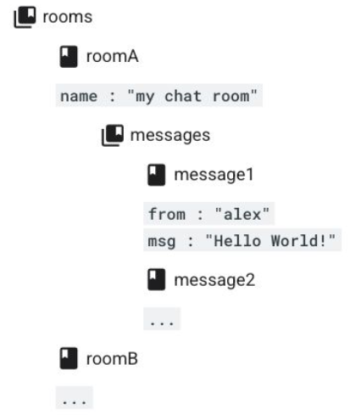
FIRESTORE EXAMPLE
CISC332
Slide 9 of 20
18 March 2026
USING FIREBASE, WHAT IF WE WANT TO DESIGN A MESSAGING APP WITH CHAT ROOMS AND MESSAGES?
There have been two rooms implemented – Room A and Room B.
In Room A, one message has been sent by “Alex” who wrote “Hello World!”
We can also expand it so John can write back a Message 2, and so on. Additionally, Room B can have messages so Alice and Bob can message. Additional rooms (C, D, …) can also be created.
Notice how organised it is. We have a collection “Rooms” which contain documents Room A, Room B, etc. Then in Room A, we have a collection of messages, such as message 1 and message 2, etc.
But can we have nested documents, or arrays? No. This is a rigid structure lacking flexibility

Slide 10
INTRO TO JSON
CISC332
Slide 10 of 20
18 March 2026
So how do APIs exchange data between systems?
They can use JSON
JavaScript Object Notation (JSON) is a text format good for storing and transporting data between computers
Written as key/value pairs
Language independent
We can use JSONs to communicate between MongoDB and Firebase
Use JSON to write the data and process it using JavaScript

Slide 11
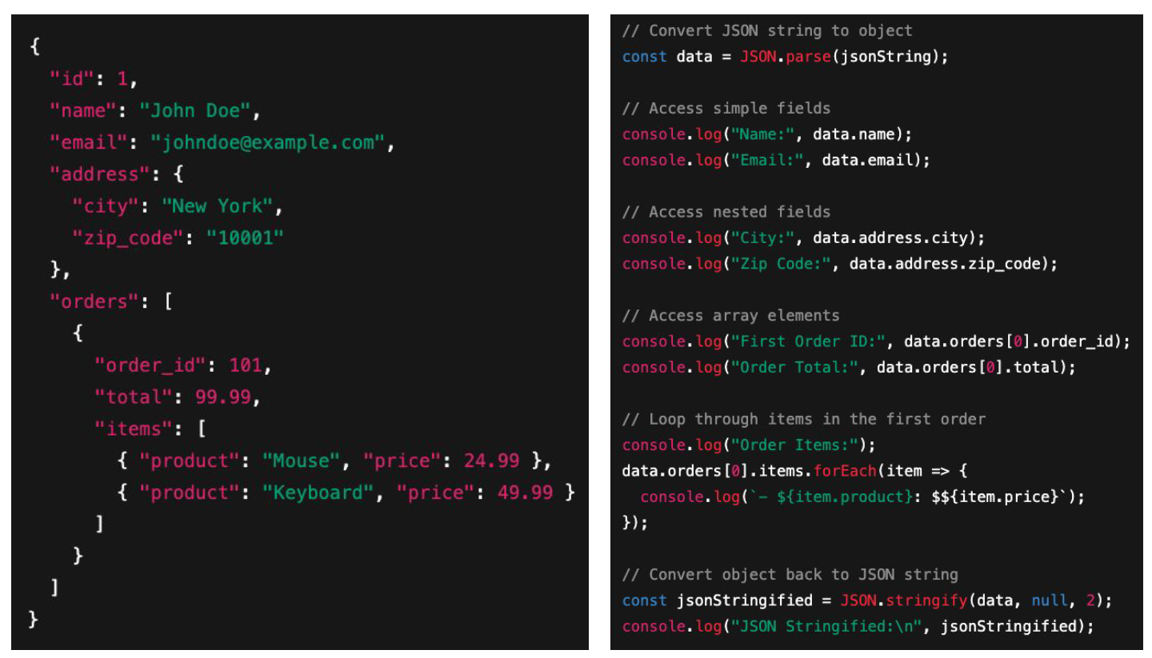
EXAMPLE OF JSON AND JAVASCRIPT
CISC332
Slide 11 of 20
18 March 2026
On the left we have a JSON Document storing data on John Doe and his order 101
On the right we have a JavaScript program that uses this data
1
2

Slide 12
INTRO TO MONGODB
CISC332
Slide 12 of 20
18 March 2026
MongoDB relies on JSON and JavaScript
A good development environment for such is Node.js which lets you run servers, connect to databases, and process JSON
MongoDB Atlas is a cloud-based database service that allows you to use MongoDB without installing/maintaining it yourself
What are some fundamental actions that all apps need to support? CRUD Operations
Create
Read
Update
Delete

Slide 13
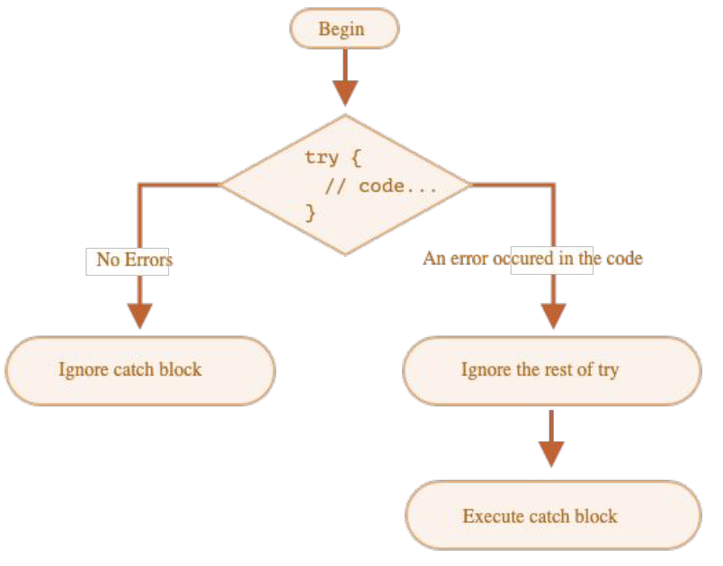
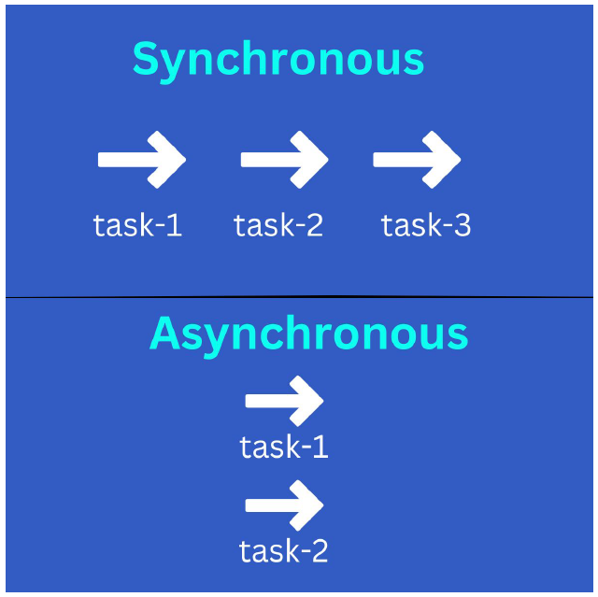
MONGODB PROGRAMMING TECHNIQUES
CISC332
Slide 13 of 20
18 March 2026
Databases operations are vulnerable to failing
Thus you should use error handling techniques like Try/Catch
try { // code } catch (error) { // handle error }
Asynchronous programming is also helpful as databases often need to run tasks without blocking each other
Synchronous usually has a task wait for the previous to complete

Slide 14
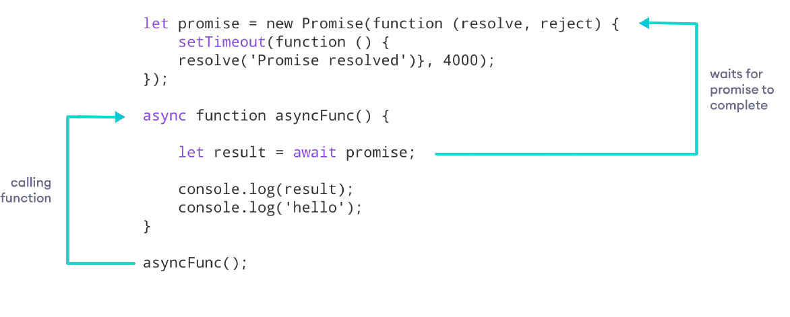
ASYNCHRONOUS PROGRAMMING - AN EXAMPLE
CISC332
Slide 14 of 20
18 March 2026
2
2
3
The function is called
It waits for the promise to complete
Then continues execution
1

Slide 15
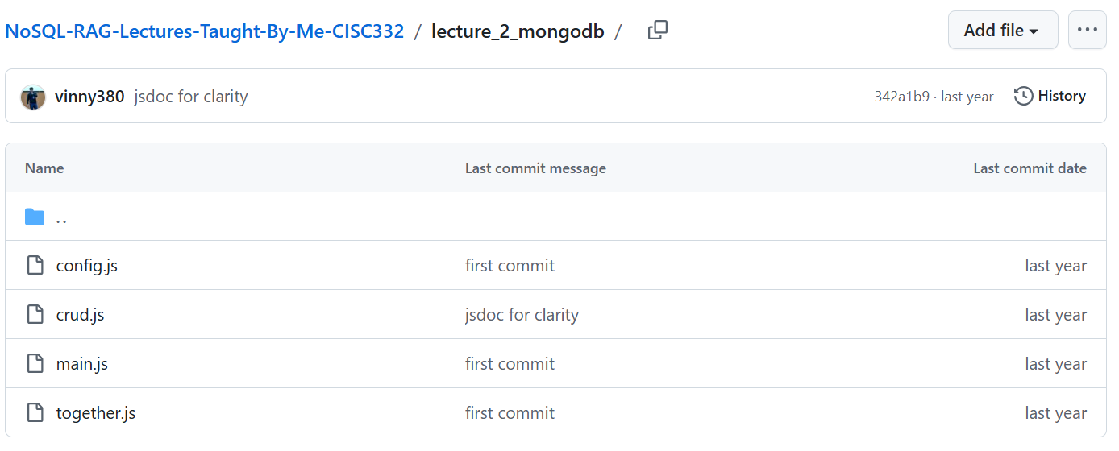
MONGODB EXAMPLE (1/5)
CISC332
Slide 15 of 20
18 March 2026
In the MongoDB Example, there are four files:
config: connection setup
crud: database operations
main: entry point
together: combined example

Slide 16
MONGODB EXAMPLE (2/5)
CISC332
Slide 16 of 20
18 March 2026
(1) Database configuration
Purpose:
This file is responsible for connecting to MongoDB Atlas.
Typically contains:
MongoDB connection string (URI)
Code to initialise the database client
Steps:
Import MongoDB client
Load environment variables
Get the connection string
Create the MongoDB client

Slide 17
MONGODB EXAMPLE (3/5)
CISC332
Slide 17 of 20
18 March 2026
(2) Database operations
Purpose:
Implements CRUD operations.
Function || Purpose
createMovie || Insert data
readMovies || Retrieve one movie (querying)
updateMovie || Modify data
deleteMovie || Remove data
getComedyMovieStats || Analyse data (aggregation)
getAllMovies || Retrieve all data
This file does NOT connect to MongoDB
It assumes movies collection is already passed in

Slide 18
MONGODB EXAMPLE (4/5)
CISC332
Slide 18 of 20
18 March 2026
(3) Entry point
Purpose:
This is the starting point of the program.
It:
Connects to the database
Calls functions from crud.js
Steps/Components:
Import everything – modular design
Connect to MongoDB
Select database
Select collection
Runs the functions from previous file
Alternate main function for simpler testing

Slide 19
MONGODB EXAMPLE (5/5)
CISC332
Slide 19 of 20
18 March 2026
(4) All-in-one version
Purpose:
This file likely combines everything into one script.
Why?
Easier to understand for beginners
Quick testing
So instead of splitting into multiple files, everything is in one place.
“Simplified version of the whole project”
Steps:
Import connection
Connect to MongoDB
Select database + collection
Query using a nested field (VERY important)
Loop through results
Access nested data
Access coordinates
Error handling
Close connection

Slide 20
REFERENCES:
CISC332
Slide 20 of 20
18 March 2026
ADDITIONAL RESOURCES FOR JavaScript and WebDev:
https://www.w3schools.com/js/default.asp (JavaScript tutorial)
https://www.youtube.com/playlist?list=PLTjRvDozrdlxEIuOBZkMAK5uiqp8rHUax (JavaScript Playlist)
https://nextjs.org/learn/react-foundations (React)
https://vuejs.org/guide/introduction.html (Vue)
https://learn.mongodb.com/learning-paths/introduction-to-mongodb (MongoDB)
CODES:
Code by Vinicius P. Purgato, March 2025: https://github.com/vinny380/NoSQL-RAG-Lectures-Taught-By-Me-CISC332
THANK YOU FOR ATTENDING TODAY’S LECTURE.
IF YOU HAVE ANY QUESTIONS, PLEASE LET ME KNOW.
(My email is ashfi.shah@queensu.ca)

